Slide 1
CSE1201: Object Oriented Programming-I (C++)
Lecture 5

Slide 2
Outline
Array
Function

Slide 3
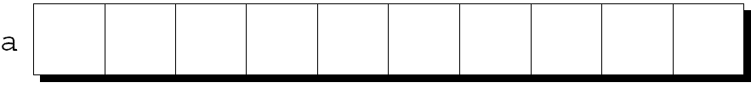
Arrays
An array is a data structure containing a number of data values, all of which have the same type.
These values, known as array elements, can be individually used by their position within the array.
An array is a contiguous piece of memory
The simplest kind of array has just one dimension.
The elements of a one-dimensional array a are conceptually arranged one after another in a single row.

Slide 4
Defining Arrays
When defining arrays, specify
Name
Type of array (Array can be defined over any type)
Number of elements
General form:
arrayType arrayName [numberOfElements];
Examples:
float grade[ 7 ];
int c[ 10 ];

Slide 5
Defining Arrays
Defining multiple arrays of same type:
Format similar to regular variables
Example:
int b[ 100 ], x[ 27 ];

Slide 6
Array Elements
Name of array (Note that all elements of this array have the same name, c)
To refer to an element, specify
Array name for the collection
Position number for the member
Format:
arrayname[ position number ]
Remember:
First element at position 0
n element array named c:
c[ 0 ], c[ 1 ]...c[ n – 1 ]
c[0]
-45
c[1]
6
c[2]
0
c[3]
72
c[4]
1543
c[5]
-89
c[6]
0
c[7]
62
c[8]
-3
c[9]
1
c[10]
6453
c[11]
78
Position number of the element within array c

Slide 7
One-Dimensional Arrays
To declare an array, we must specify the type of the array’s elements and the number of elements:
int a[10];
The elements may be of any type; the length of the array can be any (integer) constant expression
int x[y+6];

Slide 8
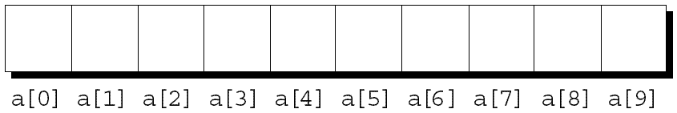
Array Subscripting
To access an array element, write the array name followed by an integer value in square brackets.
This is referred to as subscripting or indexing the array.
The elements of an array of length n are indexed from 0 to n – 1.
If a is an array of length 10, its elements are designated by a[0], a[1], …, a[9]:

Slide 9
Array Subscripting
Expressions of the form a[i] can be used in the same way as ordinary variables:
a[0] = 1;
cout<<a[0];
++a[i];
In general, if an array contains elements of type T, then each element of the array is treated as if it were a variable of type T.

Slide 10
Array Example
#include <iostream>
using namespace std;
int main() {
int numbers[5];
cout << "Enter 5 numbers: " << endl; // store input from user to array
for (int i = 0; i < 5; ++i) {
cin >> numbers[i];
}
cout << "The numbers are: "; // print array elements
for (int n = 0; n < 5; ++n) {
cout << numbers[n] << " ";
}
return 0;
}
Enter 5 numbers:
11
12
13
14
15
The numbers are: 11 12 13 14 15

Slide 11
Operations with Arrays
Assignment:
x[0] = 6; /* Assign 6 to element x[0] */
y[2] = 3.1; /* Assign 3.1 to element y[2] */
Access
m = x[0];
p = y[2];
Input/Output:
the elements are handled as their types, e.g.
cin>>x[0];
cout<<x[0];

Slide 12
Operations with Arrays
In C++, you can not assign one entire array to another array
Example:
char a1[10], a2[10];
.
.
.
a2 = a1; //this is wrong
If you want to copy the values of all the elements of one array to another, you have to do by copying each element separately

Slide 13
Arithmetic Operations
int main()
{
double x[5];
x[0] = 1;
x[1] = 2;
x[2] = x[0] + x[1]; /* X[2] = 3 */
x[3] = x[2] / 3; /* X[3] = 1 */
x[4] = x[3] * x[2]; /* X[4] = 3 */
return 0;
}
Variable Declaration for the array

Slide 14
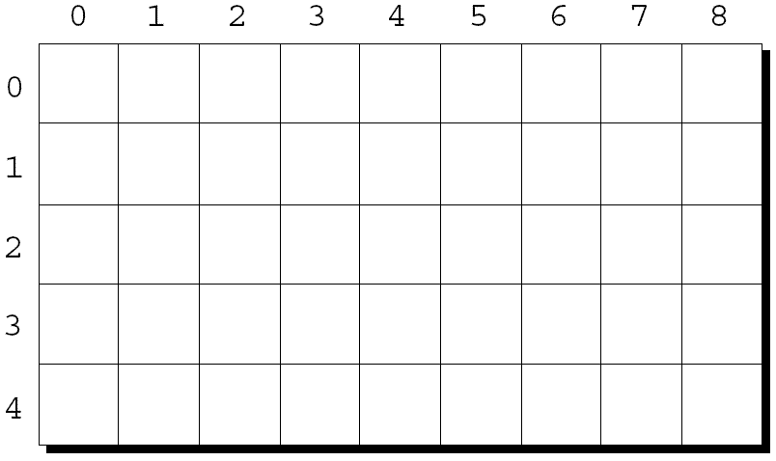
Multidimensional Arrays
An array may have multiple dimensions.
General form: type name[size₁][size₂]…[size_{n}];
The following declaration creates a two-dimensional array (a matrix, in mathematical terminology):
int m[5][9];
m has 5 rows and 9 columns. Both rows and columns are indexed from 0:

Slide 15
Multidimensional Arrays
To access the element of m in row i, column j, we must write m[i][j].
The expression m[i] designates row i of m, and m[i][j] then selects element j in this row.

Slide 16
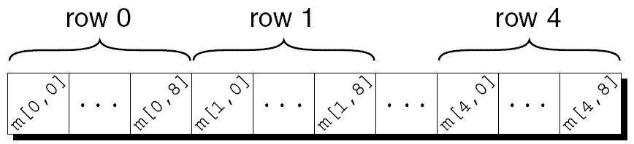
Multidimensional Arrays
Although we visualize two-dimensional arrays as tables, that’s not the way they’re actually stored in computer memory.
C++ stores arrays in row-major order, with row 0 first, then row 1, and so forth.
How the m array is stored:

Slide 17
Array Example
#include <iostream>
using namespace std;
int main() {
int numbers[2][3];
cout << "Enter 6 numbers: " << endl; // Storing user input in the array
for (int i = 0; i < 2; ++i) {
for (int j = 0; j < 3; ++j) {
cin >> numbers[i][j];
}
}
cout << "The numbers are: " << endl; // Printing array elements
for (int i = 0; i < 2; ++i) {
for (int j = 0; j < 3; ++j) {
cout << "numbers[" << i << "][" << j << "]: " << numbers[i][j] << endl;
}
}
return 0;
}
Enter 6 numbers:
1
2
3
4
5
6
The numbers are:
numbers[0][0]: 1
numbers[0][1]: 2
numbers[0][2]: 3
numbers[1][0]: 4
numbers[1][1]: 5
numbers[1][2]: 6

Slide 18
Function
A function is a series of statements that have been grouped together and given a name.
Used to perform a specific task in the program.
Every C++ program has at least one function, which is main()

Slide 19
Function Definitions
General form of a function definition:
return-type function-name ( parameters )
{
declarations
statements
}

Slide 20
Function Definition
The return type of a function is the type of value that the function returns.
Rules governing the return type:
Functions may not return arrays.
Specifying that the return type is void indicates that the function doesn’t return a value.

Slide 21
Function Definition
After the function name comes a list of parameters
Each parameter name is preceded by a specification of its type
parameters are separated by commas

Slide 22
Defining and Calling Functions
When a function is called, execution transfers to the function
When the end of the function is reached, execution returns to a point immediately after the place at which the function was called

Slide 23
Function Calls
A function call consists of a function name followed by a list of arguments, enclosed in parentheses:
print_text();
print_value(i);
average(x, y);
If the parentheses are missing, the function won’t be called:
print_text; /* WRONG */

Slide 24
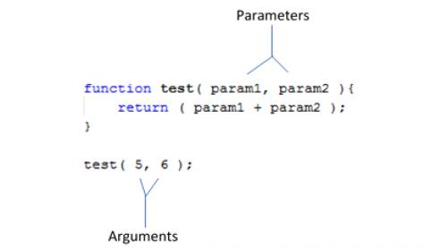
Function Parameters and Arguments
Function Parameters are the names listed in the function definition.
Function Arguments are the real values passed to (and received by) the function.
Parameters are initialized to the values of the arguments supplied.

Slide 25
The return Statement
A non-void function must use the return statement to specify what value it will return.
The return statement has the form
return expression ;
The expression is often just a constant or variable:
return 0;
return status;

Slide 26
The return Statement
return statements may appear in functions whose return type is void, provided that no expression is given:
return; /* return in a void function */
Example:
void print_int(int i)
{
if (i < 0)
return;
printf("%d", i);
}

Slide 27
The return Statement
A return statement may appear at the end of a void function:
void print_pun(void)
{
printf("To C, or not to C: that is the question.\n");
return; /* OK, but not needed */
}
Using return here is unnecessary.
If a non-void function fails to execute a return statement, the behavior of the program is undefined if it attempts to use the function’s return value.

Slide 28
Program Termination
The value returned by main is a status code that can be tested when the program terminates.
main should return 0 if the program terminates normally.
To indicate abnormal termination, main should return a value other than 0.
It’s good practice to make sure that every C++ program returns a status code.

Slide 29
Thank you

